Slide 1
Comparison Operators In R
Comparison operators in R are used to compare values and produce logical results (TRUE or FALSE) based on the comparison. These operators are fundamental for creating conditional expressions, filtering data, and making decisions in R programming.
R provides several comparison operators that allow you to compare different data types, including numeric, character, and logical values.

Slide 2
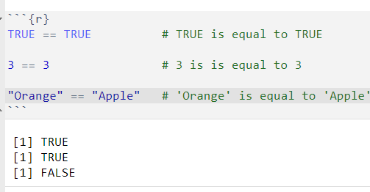
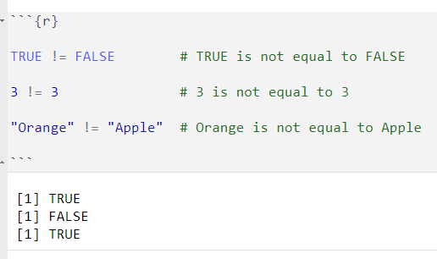
Equal To ( == )
The equal to operator `==` is used to compare if two values are equal. if the value is equal it return TRUE, otherwise FALSE.
Not Equal To ( != )
The not equal to operator `!=` compares if two values are not equal. if two values are not equal , it will return TRUE, otherwise FALSE.

Slide 3
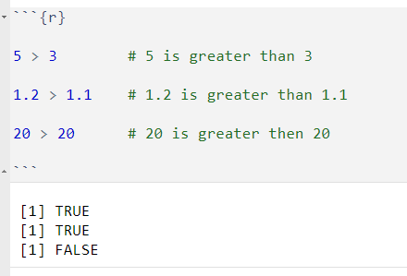
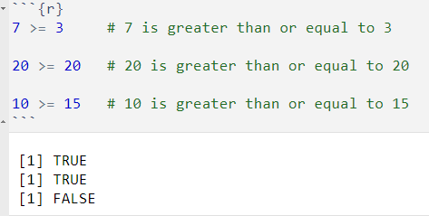
Greater Than ( > )
The greater than operator ` > ` checks if the left-hand side value is greater than the right-hand side value. if true, it returns TRUE, otherwise FALSE.
Greater Than or Equal To ( >= )
The greater than or equal to operator `>=` checks if the left-hand side value is greater than or equal to the right-hand side value. if true, it returns TRUE, otherwise FALSE.

Slide 4
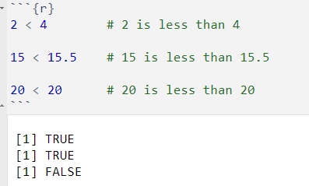
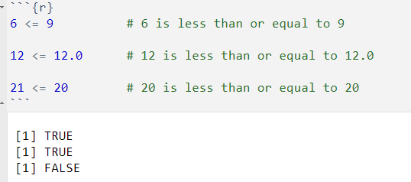
Less Than ( < )
The less than operator ` <` checks if the left-hand side value is less than the right-hand side value. if true, it returns TRUE, otherwise FALSE.
Less Than or Equal To ( <= )
The less the less than or equal to operator ` <=` checks if the left-hand side value is less than or equal to the right-hand side value. if true, it returns TRUE otherwise FALSE.

Slide 5
Logical Operators In R
Logical operators in R are used to combine or manipulate logical values (Boolean values: TRUE or FALSE) and are crucial for performing conditional evaluations, creating complex conditions, and controlling the flow of code execution.
R provides three main logical operators:
"AND" ( & )
"OR" ( | )
"NOT" ( ! )

Slide 6
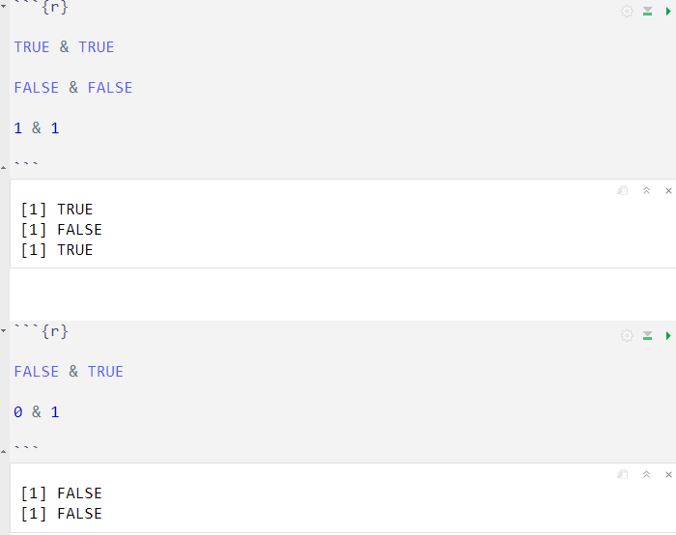
AND ( & )
The AND operator evaluate two or more conditions and return `TRUE` if all conditions are true; otherwise, it return `FALSE`. It require that all individual expressions connected by '&' must be TRUE for final result to be `TRUE.`

Slide 7
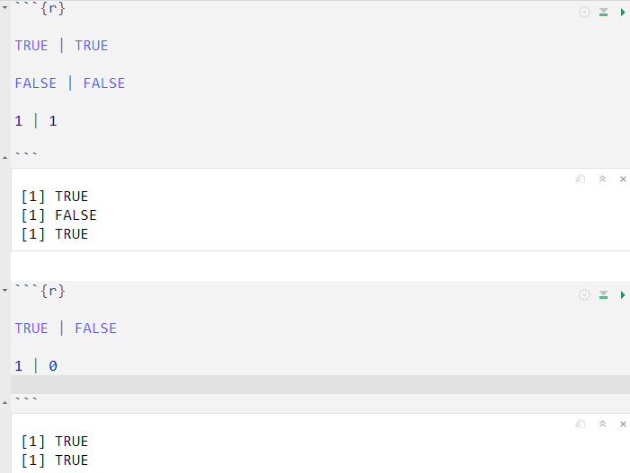
OR ( | )
The OR operator evaluate two or more conditions and return TRUE if at least one of the conditions is TRUE; otherwise, it returns FALSE. it requires that at least one of the individual expressions connected by ( | ) must be TRUE for the final result to be TRUE.

Slide 8
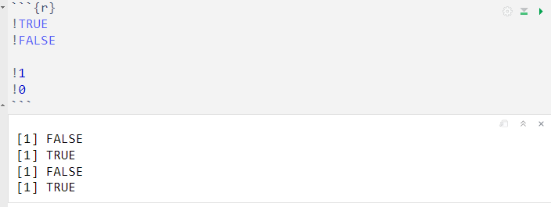
NOT ( ! )
The NOT operator negates a single logical expression and return the opposite value. it converts TRUE to FALSE and FALSE to TRUE.

Slide 9
Assignment Operators In R
In R, assignment operators are used to store values or expressions into variables. They are crucial for creating and updating variables, which are essential for data manipulation and computations in R programming.

Slide 10
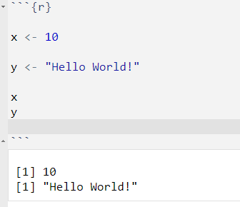
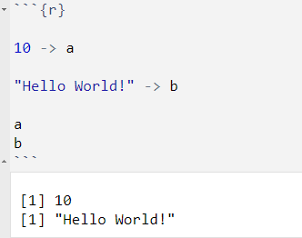
Leftward Assignment ( <- )
Also Known as the regular assignment operator, represented by <-, assigns the value on its right-hand side to the variable on its left-hand side.
Rightward Assignment ( <- )
The rightward assignment operator, assigns the value on its left-hand side to the value on its right-hand side.

Slide 11
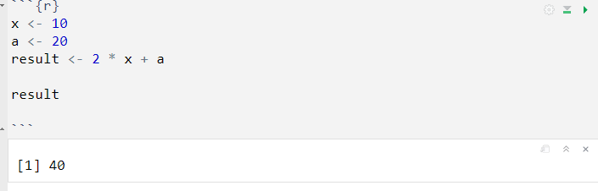
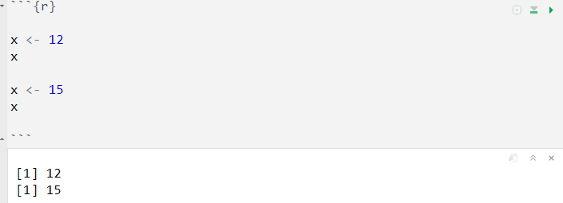
Assigning Results of Expressions :
Overwriting Variable Values :

